Slide 1
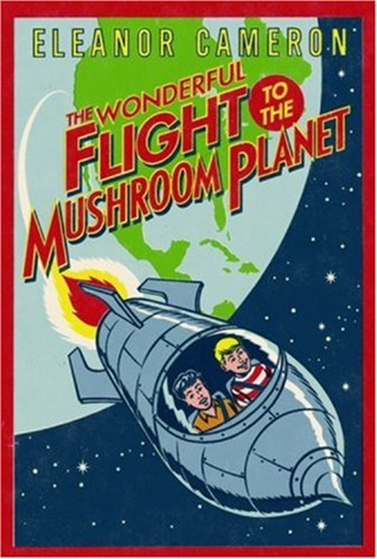
Who is the author?
What do you think the novel is about?
Who is the illustrator? What do they do?
What genre of writing do you think this is? How do you know?
What do you think the ‘flight’ might be?
Is there a Mushroom Planet? Where do you think it might be?

